Slide 1
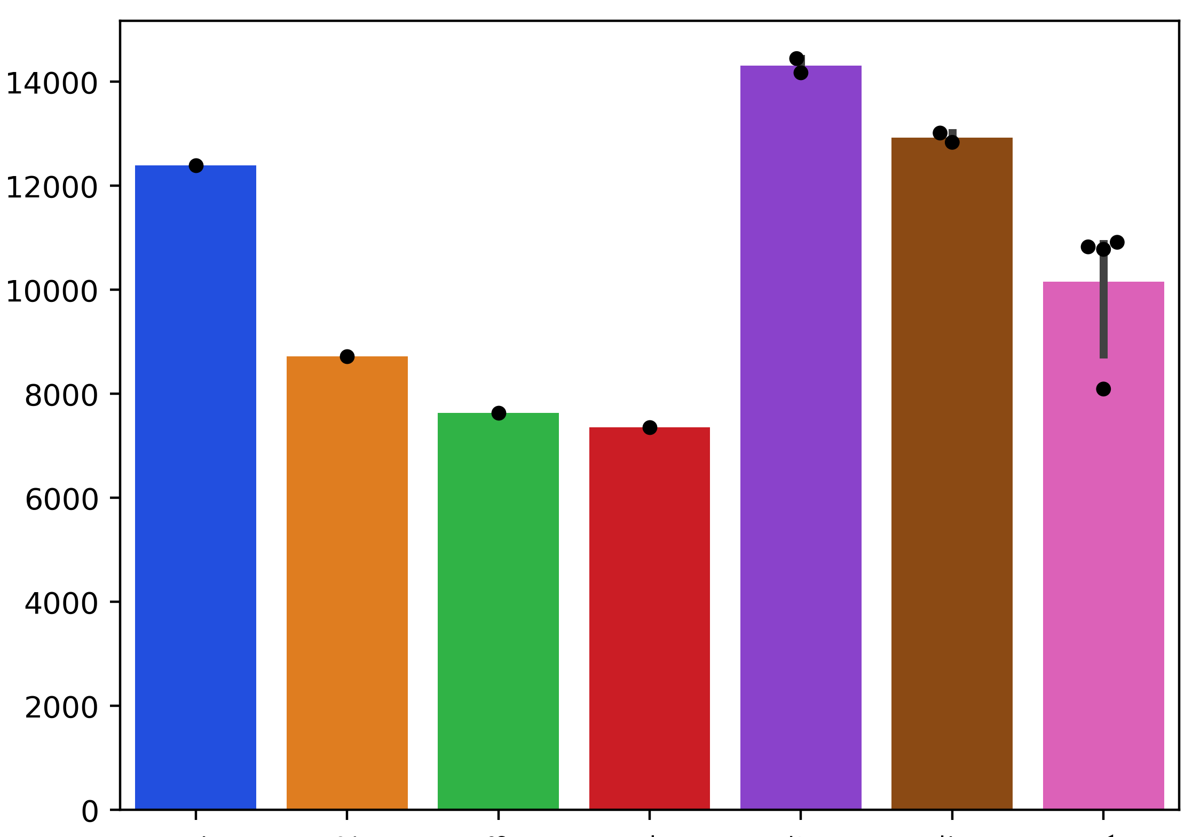
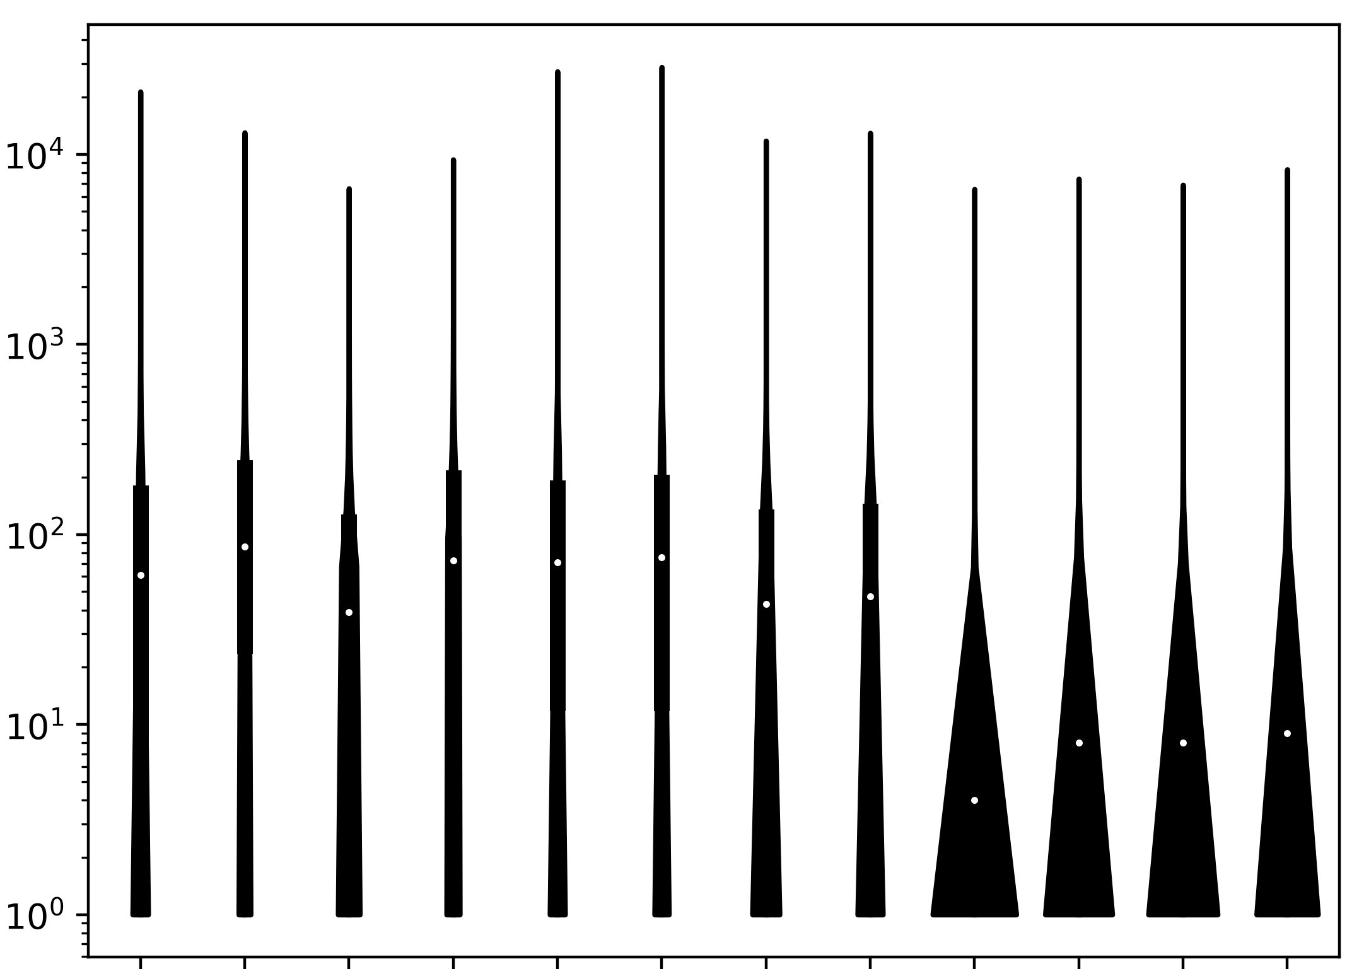
A
B
Unique genes with p-m⁵C
Unique p-m⁵c sites per gene
MT-D
MT-A
MT-D
Huang 3
MT-B
MT-A
MT-B
MT-C
Total RNA
Huang
MT-C
Huang 1
Total RNA 2
Huang 2
Huang 4
Polysome RNA
Total RNA 1
Polysome RNA 2
Polysome RNA 1
Notes:
A) Number of unique genes that carry p-m⁵C sites with at least 10x coverage. Points represent individual libraries B) Number of unique p-m⁵C site locations with at least 10x coverage for each bisulfite converted library.

Slide 2
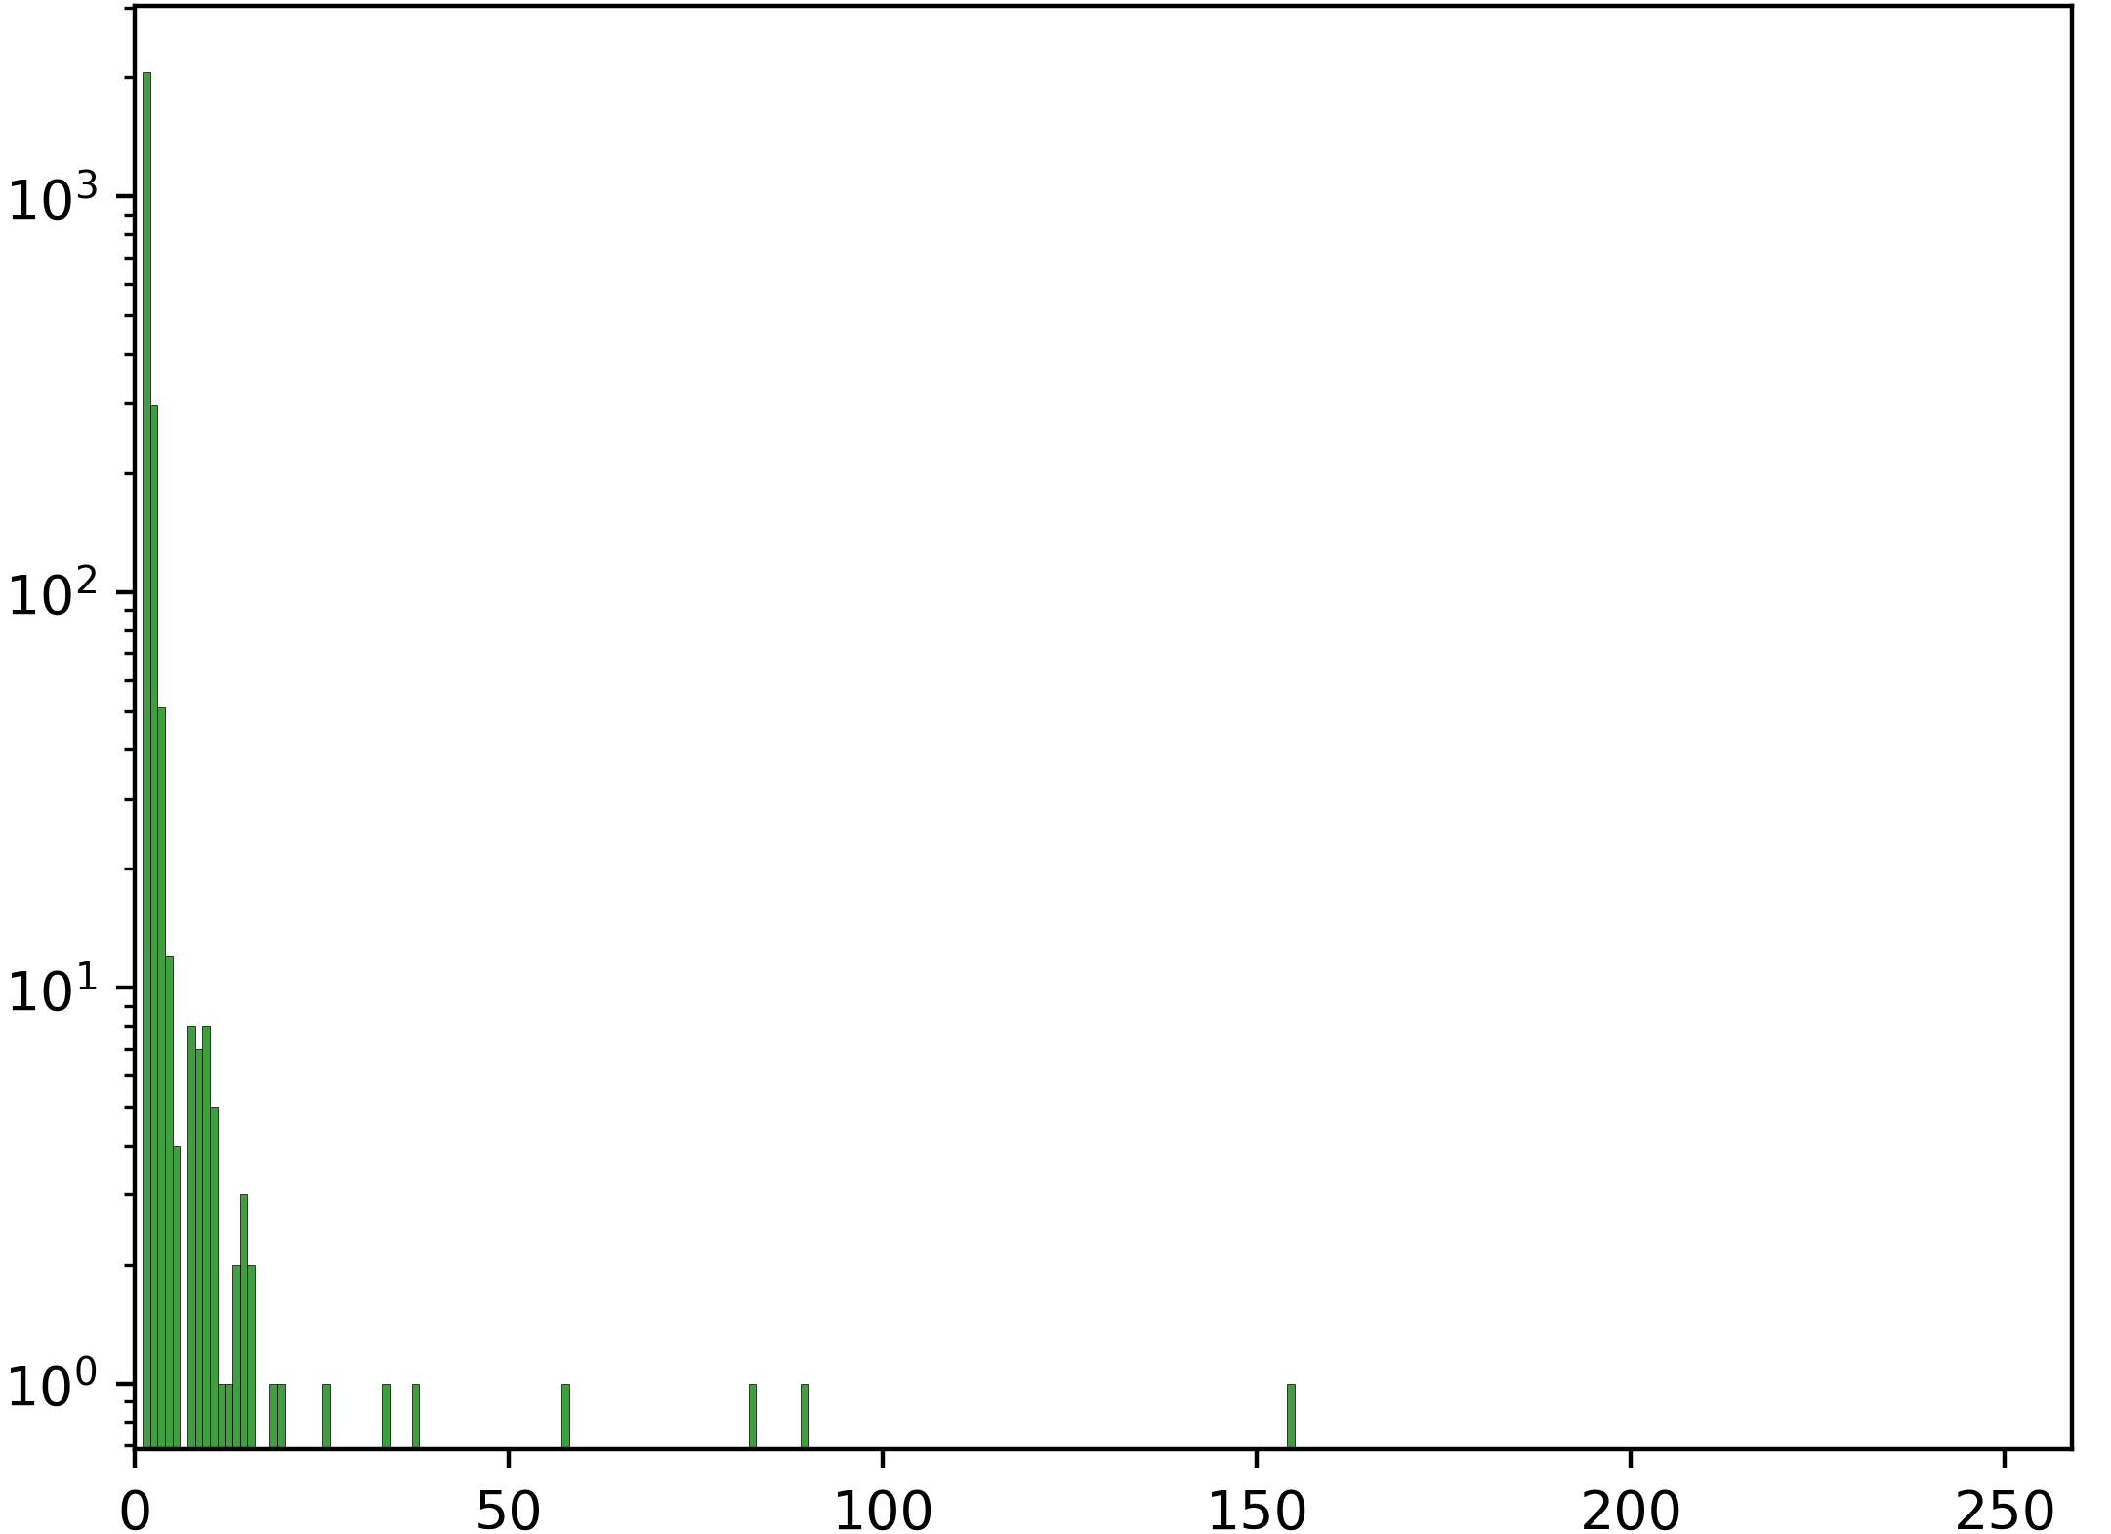
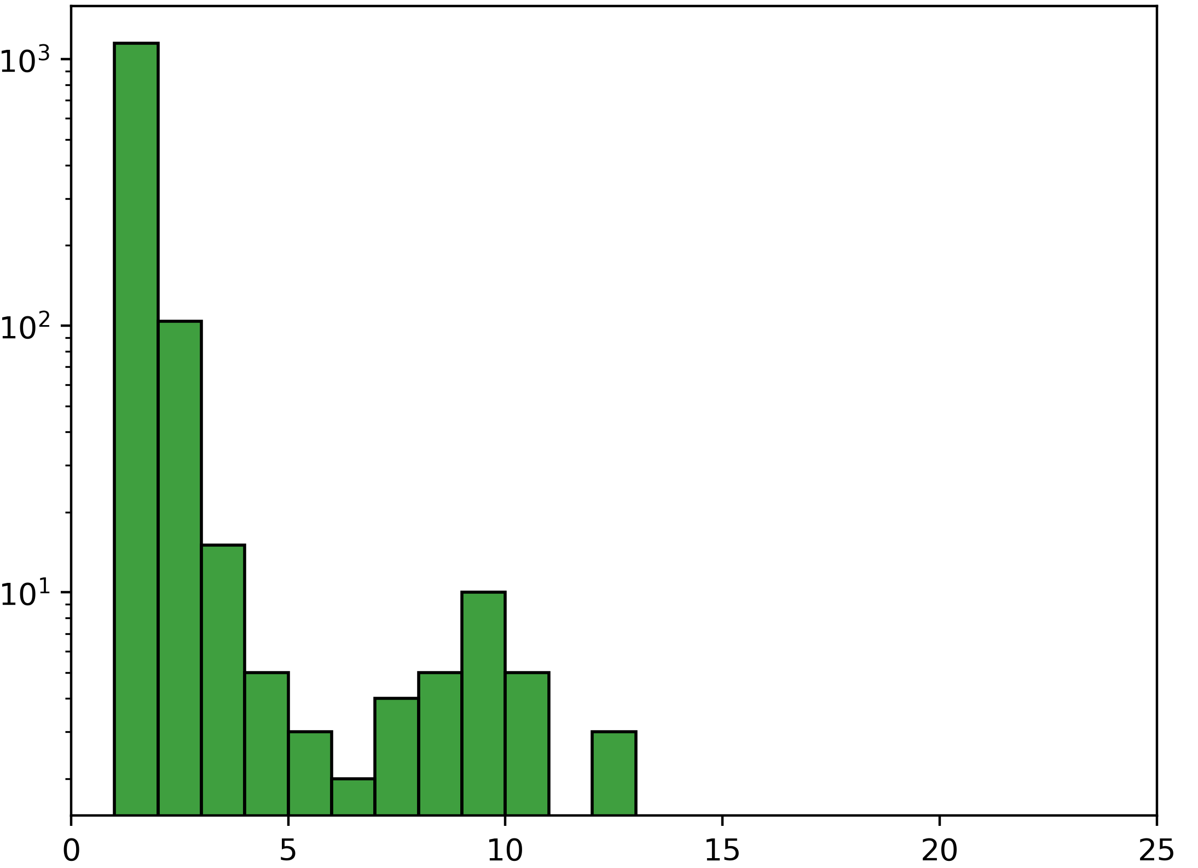
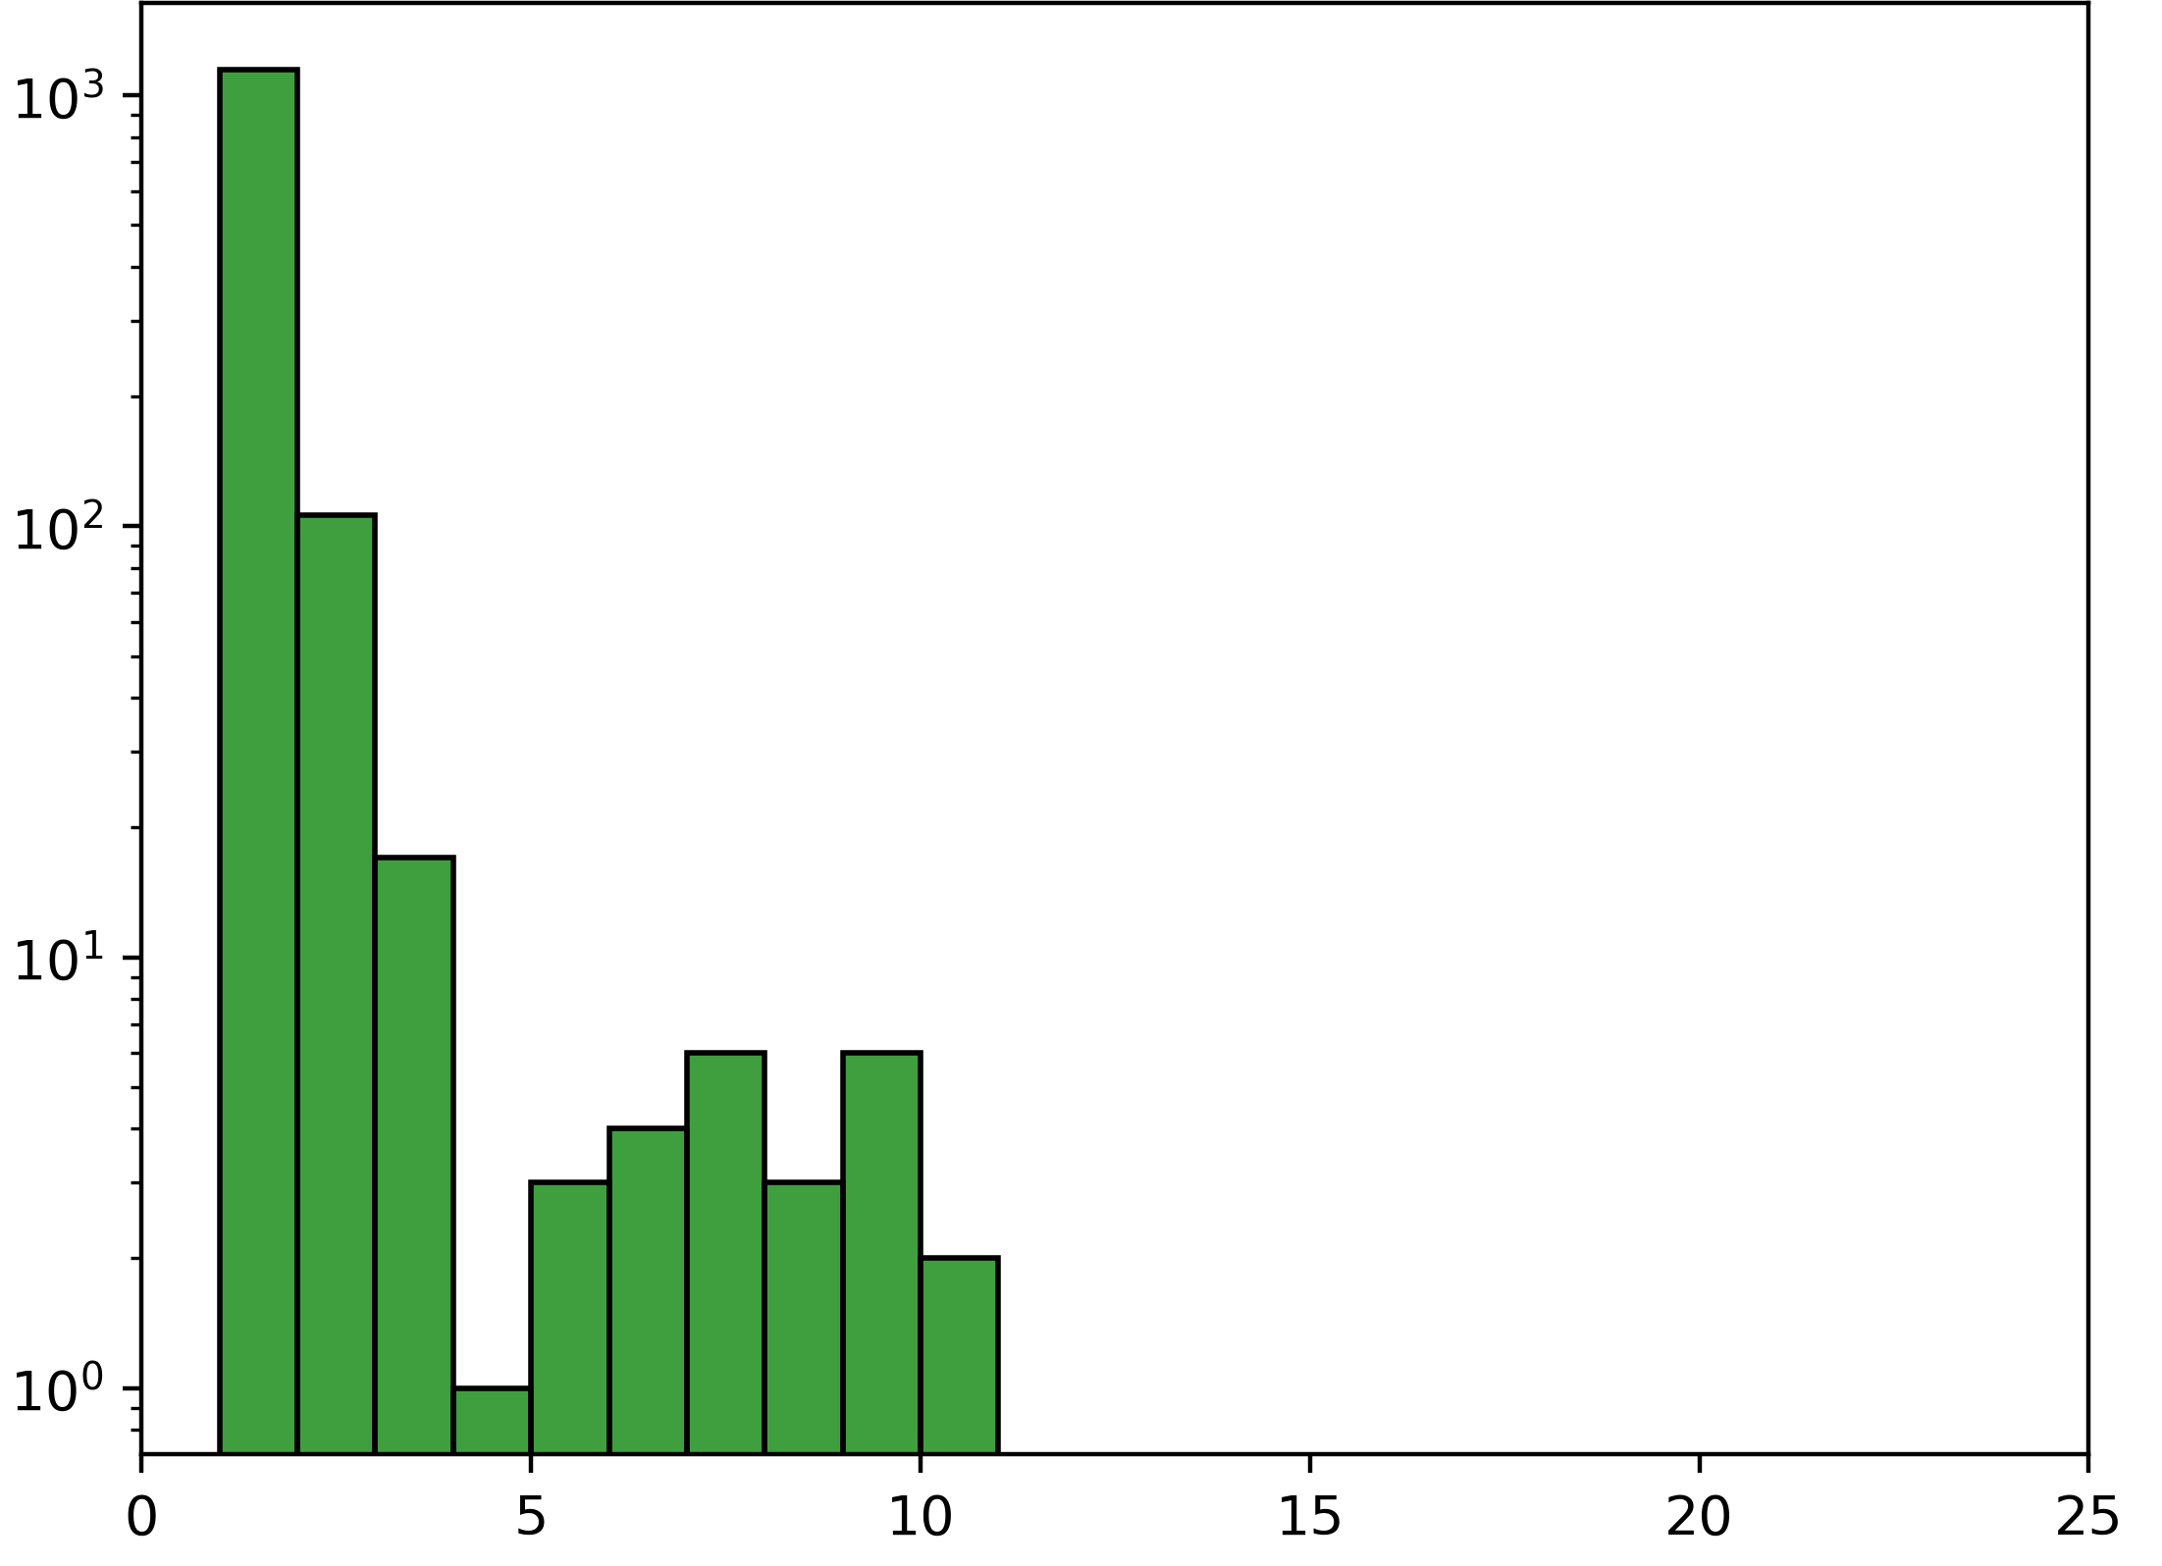
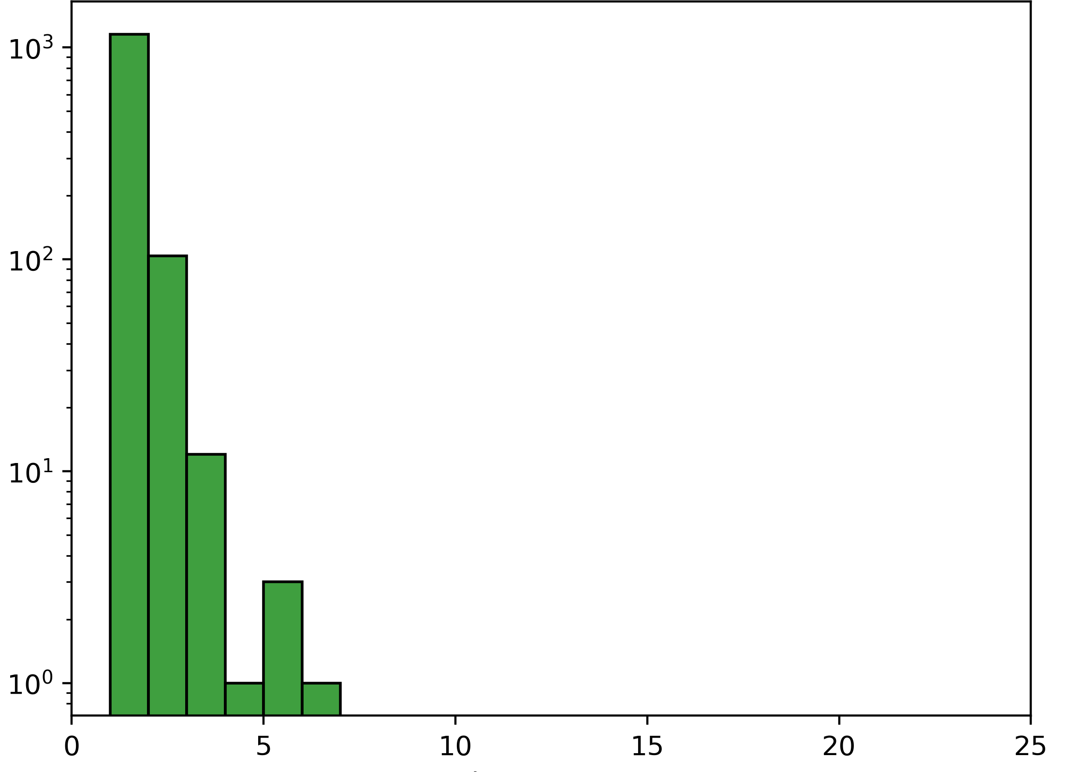
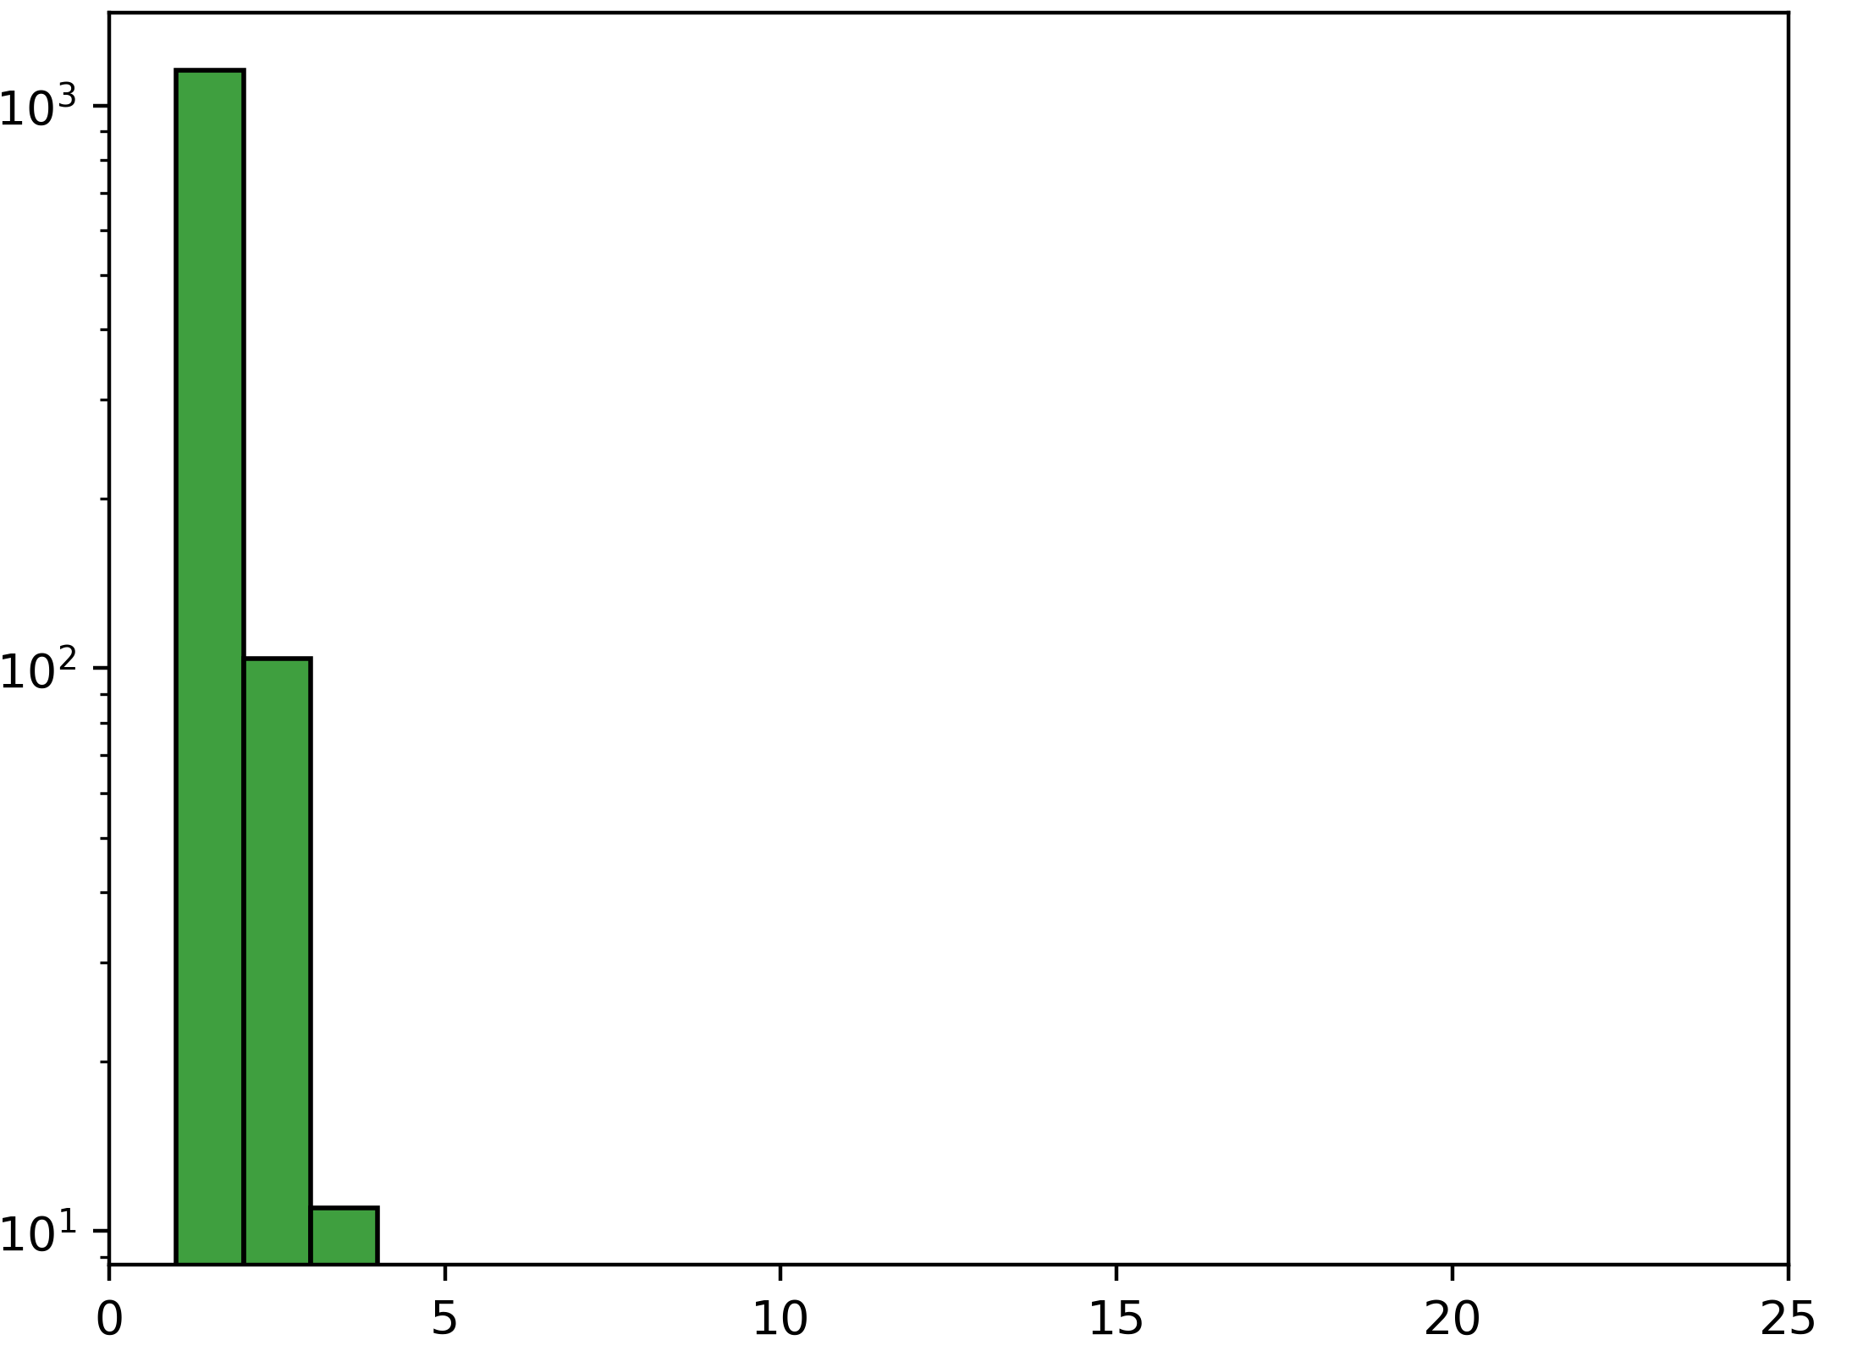
C
C-cutoff: None
Gini index: 0.3623
C-cutoff: 15
Gini index: 0.2320
C-cutoff: 8
Gini index: 0.1796
C-cutoff: 5
Gini index: 0.1005
Unique Genes
C-cutoff: 4
Gini index: 0.0905
C-cutoff: 3
Gini index: 0.0819
C-cutoff: 2
Gini index: 0.0791
C-cutoff: 1
Gini index: 0.0673
p-m⁵C Count per gene
Notes:
C) Effect of the C-cutoff filter on number of unique genes in a library. Total RNA replicate 1 is used as a representative sample.

Slide 3
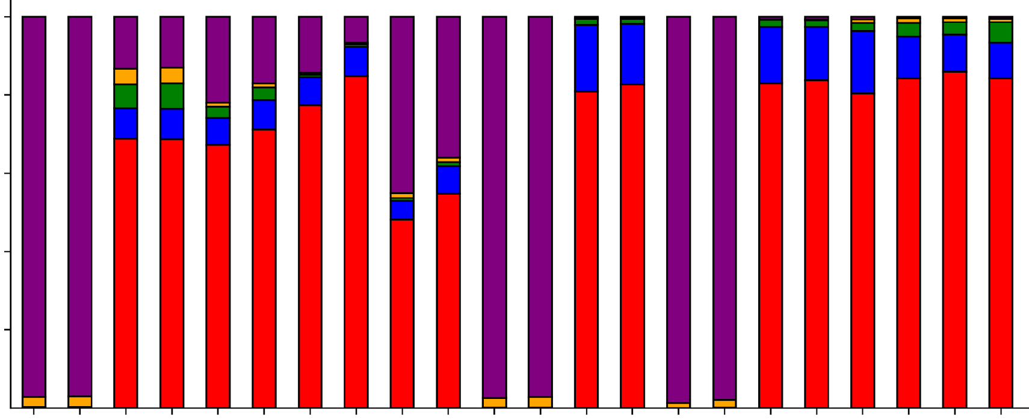
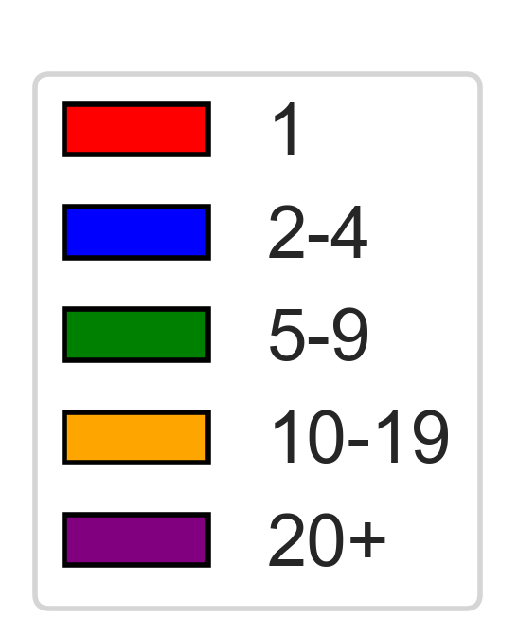
D
1.0
0.8
0.6
0.4
0.2
0
p-m⁵Cs per read
Proportion
Mitochondrial RNA
Total RNA
Polysome RNA
Huang
RNAseq
MT-A
MT-B
MT-C
MT-D
RNAseq
BS-seq
RNAseq
BS-seq

